Slide 1

Policy and measures
for energy efficiency
Sizing the investment potential
in the residential sector
Credito al Credito 2026, Panel B4, 1 Aprile 2026
Alessandro Fiorini, ENEA

Slide 2
Energy efficiency policy framework
The EU and Italian perspective
EU layer
Energy Efficiency Directive – Recast (DIR 2023/1791, EED-3):
10/10/2023
11/10/2025
Art. 3: Energy efficiency first
Art. 8(3): Preferential access to vulnerable households
Art. 30: Key role of a National Energy Efficiency Fund
Energy Performance in Buildings Directive – Recast (DIR 2024/1275, EPBD-4):
28/05/2024
29/05/2026
Art. 9: MEPs and renovation trajectories
Art. 17: Financing (in particular, sec. 7)
National layer
EU Delegation Law 2024 (11 June 2025)
EU Delegation Law 2025 (12 March 2026)
RED-3
21/05/2025
INFR(2024) 0232
21/05/2025
EED-3: Not-included
2027 (?)
EED-3
11/10/2025
INFR(2025) 0334
EPBD-4: Not included
2027 (?)
EPBD-4 (art. 3)
31/12/2025
INFR(2026) 2024
Credito al Credito 2026 – Panel B4: La nuova frontiera dei finanziamenti sostenibili alle famiglie

Slide 3
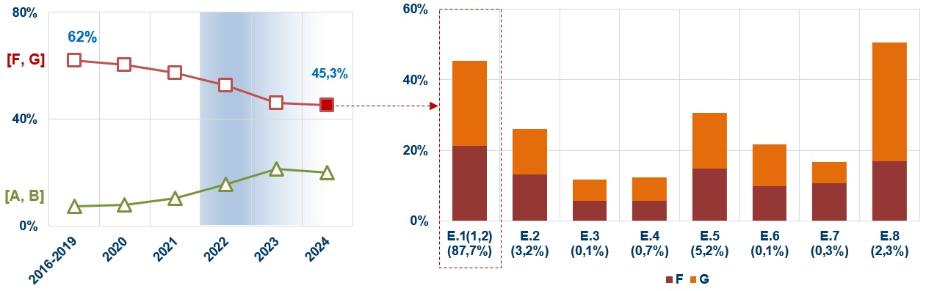
Energy efficiency policy framework
The challenges of the residential sector
Targets set by the Directives
EED-3: Total energy savings
EED-3/EPBD-4: Vulnerable households and energy poors
EPBD-4: EPI residential sector (vs. 2020)
 | Inability to keep […] | Arrears on uitlity […]
Italy | 9.6 | 4.2
North-west | 6.1 | 2.9
North-east | 4.3 | 2.0
Centre | 9.7 | 3.7
South | 17.5 | 6.9
Islands | 12.8 | 7.1
−16%
−22%
Status/conditions of the building stock
Built before 1980
EPC class F,G
14M sqm =
19k buildings
180k households =
500k individuals
Credito al Credito 2026 – Panel B4: La nuova frontiera dei finanziamenti sostenibili alle famiglie

Slide 4
Active and planned measures
National Energy and Climate Plan (PNIEC, June 2024)
NECP(June 2024): "ambition and pragmatism" (73.4 Mtoe)
Measures:
Planned savings 2021-2030
Actual savings 2024
White Certificate (OOSS)
Fiscal deductions (blds)
Thermal Account
National EE Fund (NEEF)
Transition plan 4.0 (5.0)
Public blds (PREPA(C)
Cohesion policy
Information and training
NRRP measures
Kyoto Fund
Energy savings (Public sec)
MEPs
Sustainable transports
Mtoe
Mtoe
Credito al Credito 2026 – Panel B4: La nuova frontiera dei finanziamenti sostenibili alle famiglie

Slide 5
Active and planned measures
Social Climate Plan (August 2025)
First draft (May 2025)
"Second draft" (August 2025)
EUR 3.27 Bi
EUR 3.2 Bi
Public consultation
29 May-15 June 2025
Households
(Social housing, EPC: F,G)
Vulnerable micro-enterprises
(Buildings, EPC: F,G)
Total SCP allocation: 4 measures/9.3Bi
Under revision by the EC
Total SCP allocation: 12 measures/EUR 8.7Bi
EC website says “not submitted”
Additionality: extension of target buildings, focus on EPC = F,G
EED/SCP
Complementarity: eligibility criteria, operational and financial synergies (resource optimisation)
Credito al Credito 2026 – Panel B4: La nuova frontiera dei finanziamenti sostenibili alle famiglie

Slide 6
Active and planned measures
Support measures – State of the art
NECP 2024 (1/2)
Name | Type/Mechanism | Beneficiary/Recipient | Eligible interventions | Intensity of support
Ecobonus | Fiscal deduction Fiscal capacity 10 annual instalments | Individuals (residential) Condominiums Companies Owners and tenants of existing buildings (bear the costs) | Energy performance improvement Dwelling, building Plants (ex: fossil fuels): ≤ EUR 30k Fabric ≤ EUR 60k Common parts ≤ EUR 100k |  | 2026: 50% 2027-2028: 36%
 |  |  |  |  | 2026: 36% 2027-2028: 30%
Bonus Casa | Fiscal deduction Fiscal capacity 10 annual instalments | Individuals | Structural renovation (ordinary and extra) Dwelling, building Plants : ≤ EUR 95k Fabric: ≤ EUR 95k Building (common parts): ≤ EUR 95k |  | 2026: 50% 2027-2028: 36%
 |  |  |  |  | 2026: 36% 2027-2028: 30%
Thermal account 3.0 (EUR 0.9Bi/yr) | Grant CapEx 5-10 annual instalments if ≥ EUR 15k) | Individuals (residential, tertiary) Condominiums: EUR 350Mi/yr ESCOs (indirect) Companies: EUR 150Mi/yr Public Administrations: EUR 400Mi/yr | Small-scale projects (EE, RES-H) Dwelling Plants (efficient heating systems and RES) |  | 40% - 65%
 |  |  |  |  | 25% - 65%
 |  |  |  |  | 65% - 100%
NEEF (EUR 0.3Bi) | Revolving (mixed scheme) 30% guarantee (a) 70%: [0.25%, up to 15 yrs] loan (b)+EUR 8Mi non-repayable | Individuals (indirect) Condominiums ESCOs Companies Public Administrations | Infrastructures (public use) Industrial processes Dwellings Plants (efficient heating systems and RES) |  | (a): 80%
 |  |  |  |  | (a): 80%/EUR 0.15-2.5M (b): 70%/EUR 0.25-4M
 |  |  |  |  | (b): 60%-80%/EUR 0.15-2M
Credito al Credito 2026 – Panel B4: La nuova frontiera dei finanziamenti sostenibili alle famiglie

Slide 7
Active and planned measures
Support measures – State of the art
NECP 2024 (2/2)
Name | Type/Mechanism | Beneficiary/Recipient | Type of interventions | Intensity of support
Cohesion funds (before: 2021-2027) | Grant CapEx Open-/Competitive call | Local administrations | Infrastructures (public use) Building (public property) | 40% - 85% (Depending on): EU fund Project Geographical area
NRPP: M.7-I.17 (EUR 1.31B) | Mixed scheme Grant (a) Loan (b) | ESCOs (assignment of a work and services contract by: SH Owners/Managers) | Large scale projects (EUR 10M-30M) Building (SH, public property) EP (gl,nren) gain: ≥ 30% | (a): Grant: 65%
 |  |  |  | (b): Loan (market rate): 35%
PSC 2025
Name | Type | Beneficiary/Recipient | Type of interventions | Intensity of support
Social housing | Grant CapEx Open call (a) | (a): SH Owners/Managers | Building (SH, public property, individual/central heating system) Dwelling Plant (efficient heating systems and RES) Fabric EPC: F,G class EP (gl,nren) gain: ≥ 20% | (a): Grant: 100%
 | Grant CapEx Competitive call (b) | (b): ESCOs (assignment of a work and services contract by: SH Owners/Managers)
 |  |  |  | (b): Grant: 65%-100% (provided additional funds requested by the ESCO)
Credito al Credito 2026 – Panel B4: La nuova frontiera dei finanziamenti sostenibili alle famiglie

Slide 8
Active and planned measures
Evidences from fiscal deduction measures implementation
Renovation and energy retrofitting investment
Turning point
Residential
2006: Ecobonus
2020: Superbonus
2022: Reshape of the incentives
L. 234/2021 (Budget Law 2022)
Structural reduction of rates
LD. 11/2023 (L. 38/2023)
Cancellation of “discount” and “transfer” option
LD. 39/2024 (L. 67/2024)
Removal of exemptions
Year | Variation (%)
2025 | -17.0%
2026 | -3.5%
Source: CRESME. ENEA
Source: CRESME
Credito al Credito 2026 – Panel B4: La nuova frontiera dei finanziamenti sostenibili alle famiglie

Slide 9
Active and planned measures
How to unlock the investment potential of energy efficiency
Prospects for EED-3 art. 8(3) implementation and fair energy transition
Name | Current design | Planned reforms (EED-3 transposition and implementation)
Fiscal deductions | Ecobonus: Accessible by TSEs (Social Coops, No profit) Accessible by tenants Deduction limits proportional to the income NB: Regardless of the deduction % | Adopt a single structural measure Avoid overlapping of interventions among measures Maximise cost-benefit balance Prioritise vulnerable individuals/groups: Link the incentive to income levels Restore prioritisation mechanisms for vulnerable households (as invoice discount and credit transfer option (removed as of 17 March 2023)
Thermal account (3.0) | Accessible by TSEs (NEW: treated as equivalent to PAs) Target RECs and S-CC (projects submitted by Individuals and Pas) [?] 100% for small municipalities (<15k inhabits) and public blds for primary services
NEEF | Target social housing buildings | Revive the measure (in particular the guarantee scheme). Objective of a specific working group within the EEFC – Italian Hub Activate the connections with other measures (e.g. Eco-loan)
Confirm the current scheme of SCP
Credito al Credito 2026 – Panel B4: La nuova frontiera dei finanziamenti sostenibili alle famiglie

Slide 10
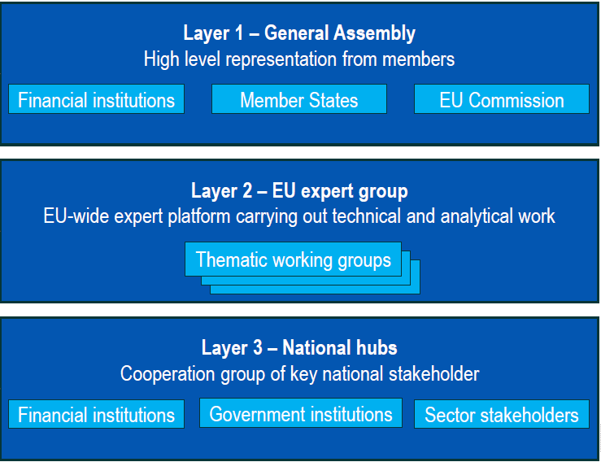


Active and planned measures
How to unlock the investment potential of energy efficiency
EU Energy Efficiency Financing Coalition
Latest development
Launch: April 2024; Kick-off: 2024
Citizens Energy Package
COM/2026/115 (10 March 2026)
House as “energy platform”
Energy investment as “risk-reduction asset”
WG: Renovation
Clean Energy Investment Strategy
Secretariat
COM/2026/116 (10 March 2026)
WG: SMEs
Structural space to credit to households
MASE
Guarantees as priority de-risking scheme
Report: EE Financing in Europe
COM/2026/118 (10 March 2026)
Italian Hub: Ongoing and planned activates
How to revive the NEEF
Energy Private Investment Mobilisation
How to address the needs of “vulnerable” private owners
REC/2026/537 (10 March 2026)
Credito al Credito 2026 – Panel B4: La nuova frontiera dei finanziamenti sostenibili alle famiglie

Slide 11
EC – Energy Efficiency Financing Coalition
#EEEFinCoalition
alessandro.fiorini@enea.it
+39 (6) 3048.3231

